Slide 1
VALE: A Multimodal Visual and Language Explanation Framework
PIP2001 Capstone Project
Review-0
Batch Number: ISD-06
Under the Supervision of,
Dr R Vignesh
Associate Professor
School of Computer Science and Engineering
Presidency University
ROLL NUMBER | STUDENT NAME
20211ISD0024 | Subhasis Das
Name of the Program: INFORMATION SCIENCE AND TECHNOLOGY
Name of the HoD: PALLAVI R
Name of the Program Project Coordinator: Mr. Srinivas Mishra
Name of the School Project Coordinators: Dr. Sampath A K / Dr. Abdul Khadar A

Slide 2
Content
Problem Statement
Github Link
Analysis of Problem Statement
Timeline of the Project
References

Slide 3
Problem Statement:
Deep Neural Networks (DNNs) achieve high accuracy in image classification tasks but lack interpretability, making it difficult to understand their decision-making process. Existing Explainable AI (XAI) techniques either provide visual explanations (e.g., SHAP, LIME, CAM) or textual descriptions (e.g., encoder-decoder models) separately, limiting their effectiveness. There is a need for a unified framework that integrates both modalities to enhance interpretability.
This research proposes VALE (Visual and Language Explanation), a multimodal framework that combines SHAP-based visual explanations with Vision-Language Models (VLMs) for textual descriptions. By applying VALE to diverse datasets like ImageNet and SONAR classification, the study aims to improve human understanding of model predictions and bridge the semantic gap between AI and users.

Slide 4
Analysis Of Problem Statement
Literature Review
Study existing XAI methods (LIME, SHAP, CAM, LRP).
Analyze previous multimodal explanation frameworks.
Identify gaps in current research.
Understand SHAP & Vision-Language Models (VLMs)
Learn how SHAP highlights important regions in images.
Explore Vision-Language Models (BLIP, CLIP, GPT-based) for text generation.
Study how segmentation models like SAM enhance explanations.

Slide 5
Define Problem Scope & Dataset Selection
Choose datasets (e.g., ImageNet, SONAR) to validate the framework.
Determine evaluation metrics (accuracy, BLEU score, F1-score).
Develop VALE Framework
Implement CNN-based classifier (DenseNet121).
Integrate SHAP for visual explanations.
Apply SAM for segmentation.
Use VLMs to generate textual descriptions.
Optimize text generation with prompt engineering.
Experimentation & Evaluation
Train models and analyze results.
Compare VALE with existing XAI methods (LIME, SHAP-only, Text-only).
Improve performance using additional techniques.
Interpretation & Documentation
Analyze case studies demonstrating VALE’s effectiveness.
Document findings for further improvements.
Explore future enhancements (e.g., integrating LIME, LRP).

Slide 6
Github Link
The Github link provided should have public access permission.
Github Link

Slide 7
Tech Stack To Be Utilised
Platform & Language: Google Colab, Python 3.x
DL & XAI: TensorFlow/PyTorch, SHAP, LIME
Image Processing: SAM, OpenCV, PIL
VLMs: BLIP/CLIP/GPT, Hugging Face
Evaluation: Scikit-learn, NLTK, SacreBLEU
Libraries: NumPy, Pandas, Matplotlib, Seaborn

Slide 8
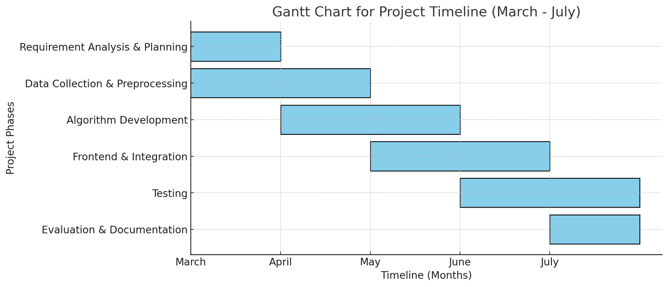
Timeline of the Project (Gantt Chart)

Slide 9
References (IEEE Paper format)
Wang, J., Mao, Y., Guan, N., & Xue, C. J. (2024). SHAP-CAT: An interpretable multi-modal framework enhancing WSI classification via virtual staining and Shapley-value-based multimodal fusion. arXiv preprint arXiv:2410.01408. https://doi.org/10.48550/arXiv.2410.01408 ​arXiv
Cafagna, G., Rojas-Barahona, L. M., van Deemter, K., & Gatt, A. (2024). Interpreting vision and language generative models with semantic visual priors. Frontiers in Artificial Intelligence, 6, 1125632. https://doi.org/10.3389/frai.2023.1125632 ​PubMed
Parcalabescu, L., & Frank, A. (2024). MM-SHAP: A performance-agnostic metric for measuring multimodal contributions in vision and language models & tasks. Proceedings of the 61st Annual Meeting of the Association for Computational Linguistics (ACL), 4032–4059. https://doi.org/10.18653/v1/2023.acl-long.223 ​ACL Anthology
Zeng, X. (2024). Enhancing the interpretability of SHAP values using large language models. arXiv preprint arXiv:2409.00079. https://doi.org/10.48550/arXiv.2409.00079 ​
Rao, V. N., Zhen, X., Hovsepian, K., & Shen, M. (2021). A First Look: Towards Explainable TextVQA Models via Visual and Textual Explanations. arXiv preprint arXiv:2105.02626.
https://arxiv.org/abs/2105.02626​
Zhang, Y., Jiang, T., Pan, B., Wang, J., Bai, G., & Zhao, L. (2024). MEGL: Multimodal Explanation-Guided Learning. arXiv preprint arXiv:2411.13053. https://arxiv.org/abs/2411.13053​arXiv
Lyu, Y., Liang, P. P., Deng, Z., Salakhutdinov, R., & Morency, L.-P. (2022). DIME: Fine-grained Interpretations of Multimodal Models via Disentangled Local Explanations. arXiv preprint arXiv:2203.02013. https://arxiv.org/abs/2203.02013​

Slide 10


